Slide 1

Iot plant monitoring system

Slide 2
Purpose of the project
Implement an autonomous system for the monitoring of plant.
Various sensors to collect measurements from the plant.
Autonomous watering.
MQTT communication.
Raspberry Pi MQTT broker.
E-mail notifications.
Real-time charts to display the measurements.

Slide 3
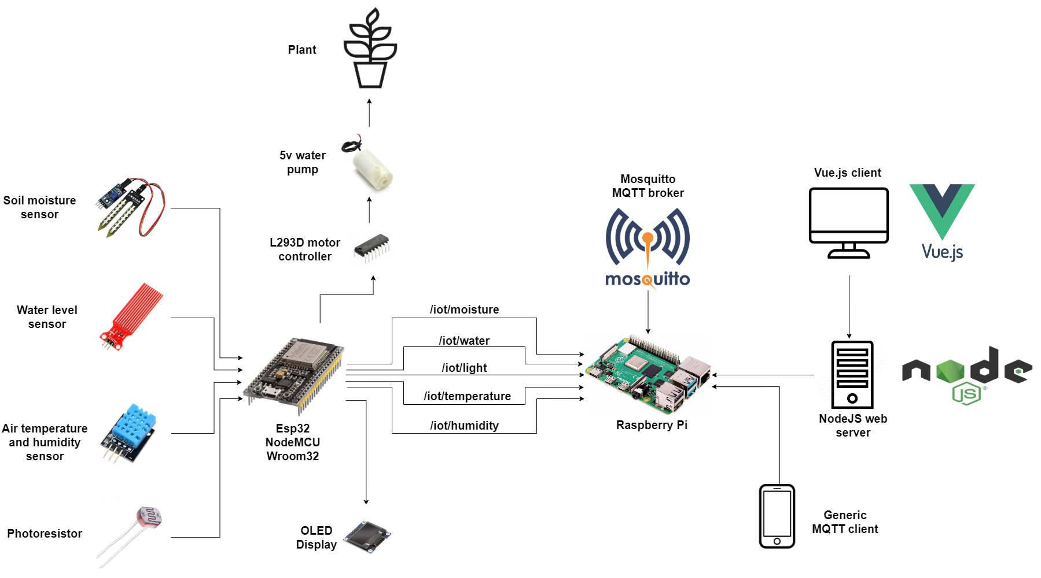
System architecture

Slide 4
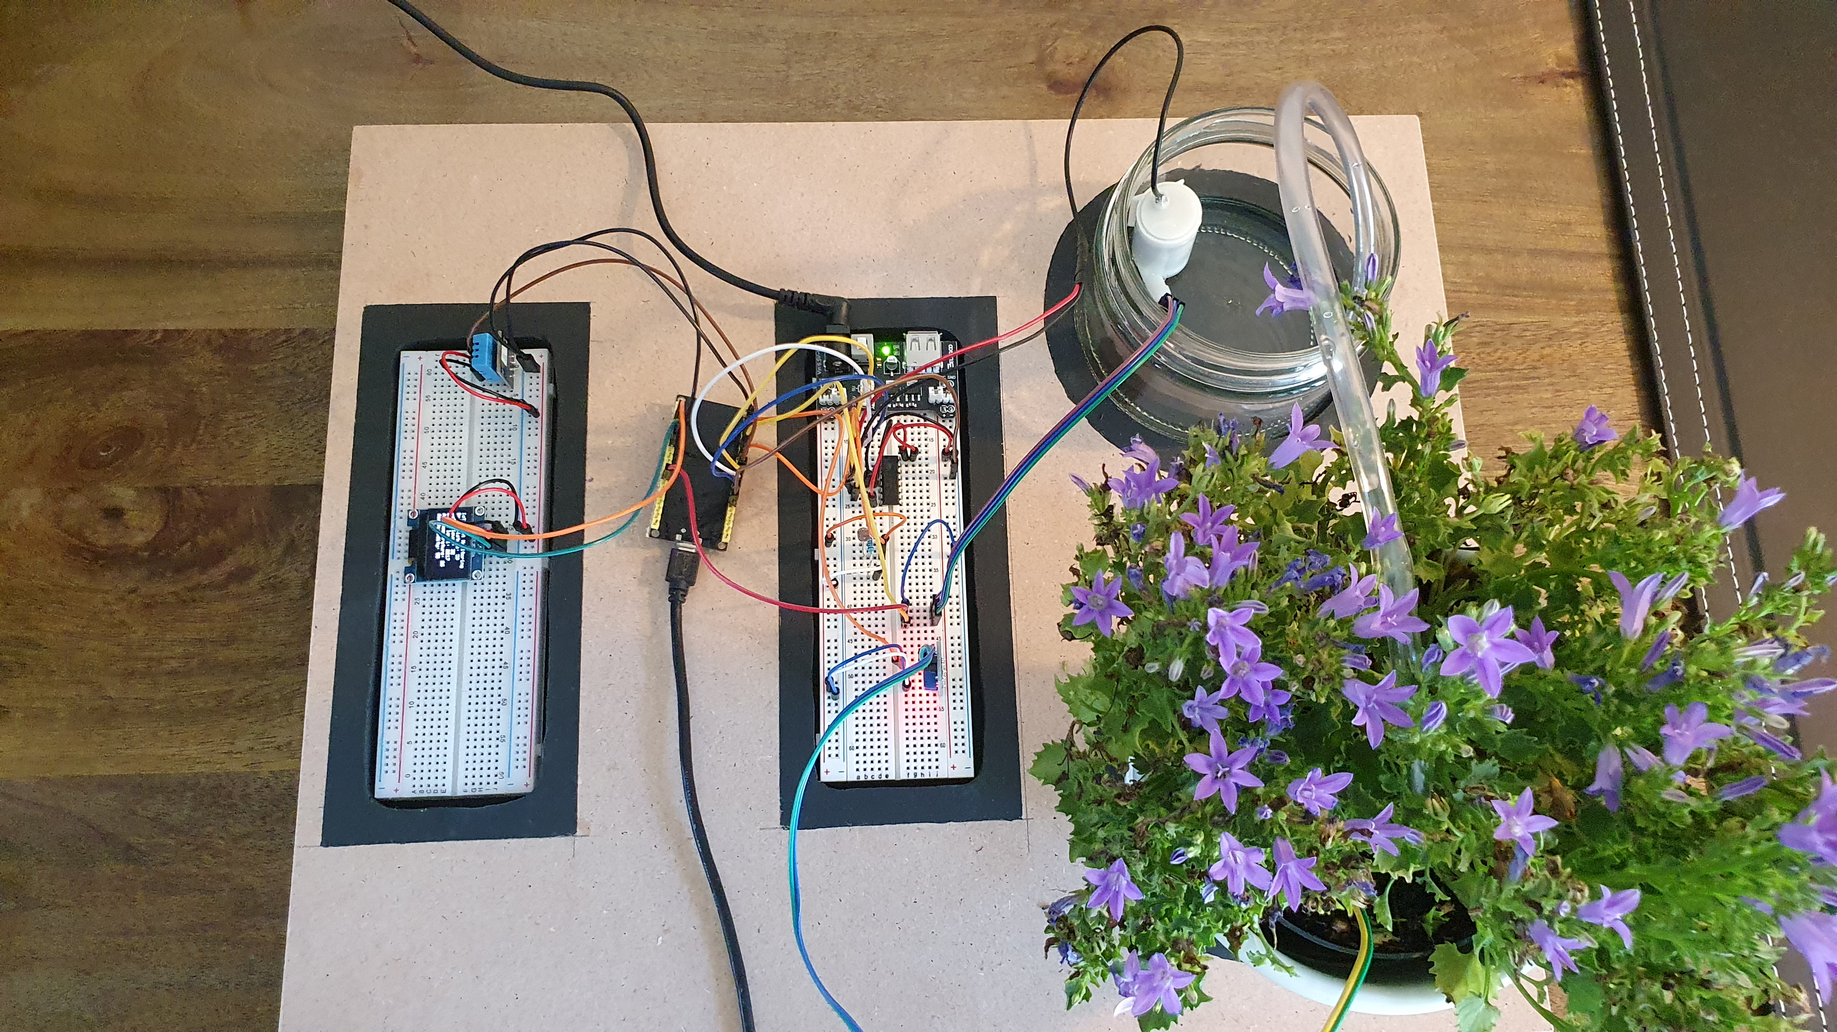
System architecture

Slide 5
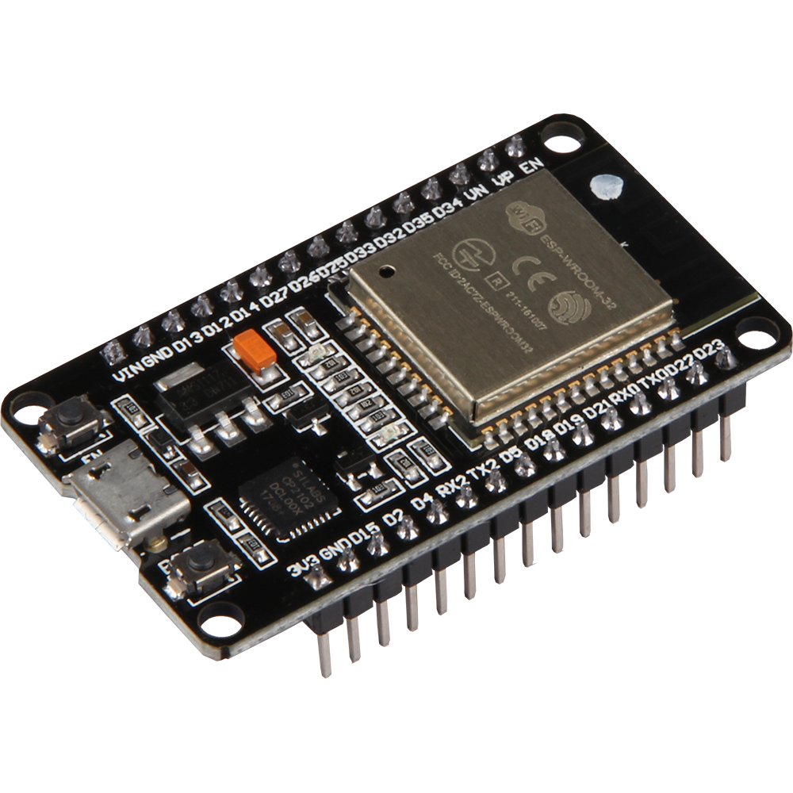
Hardware – esp32
Built-in WiFi and Bluetooth.
Greater memory size compared to Arduino Uno.
Increased number of pins.

Slide 6
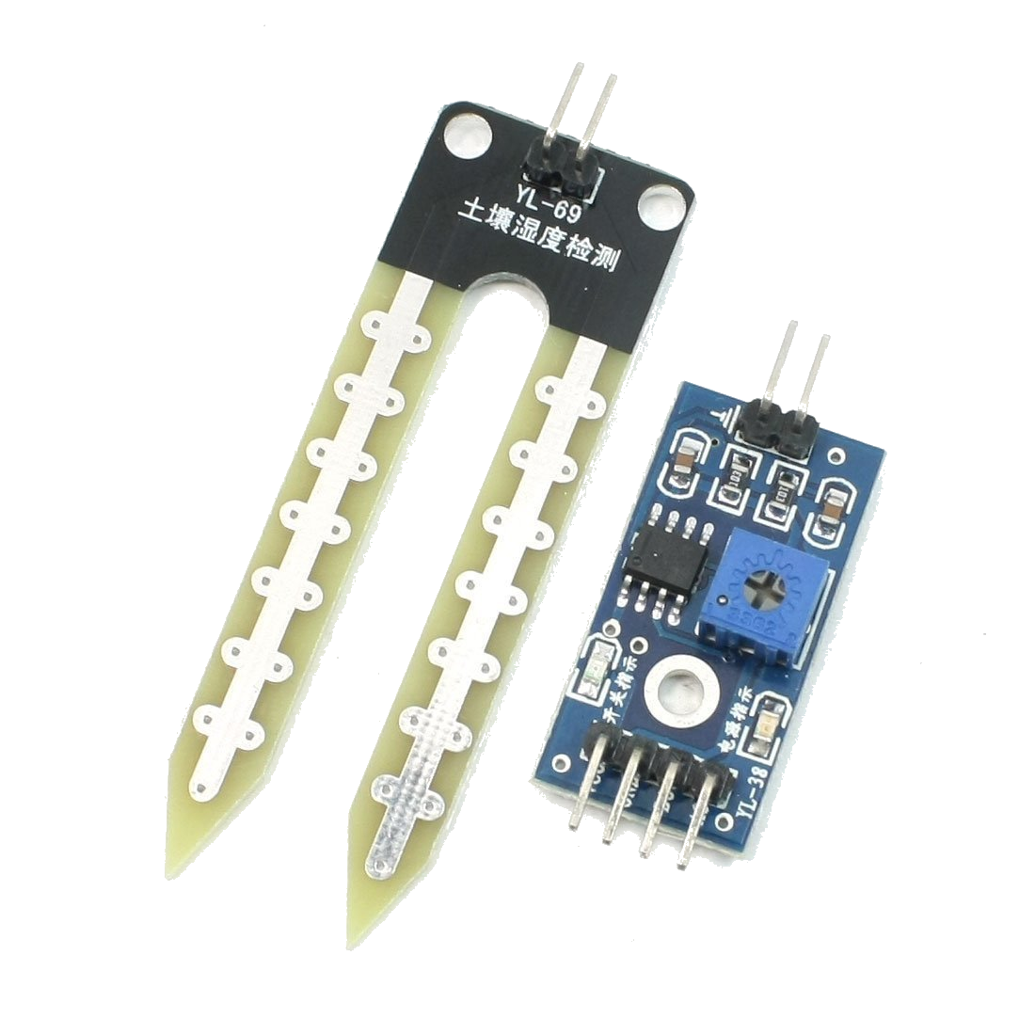
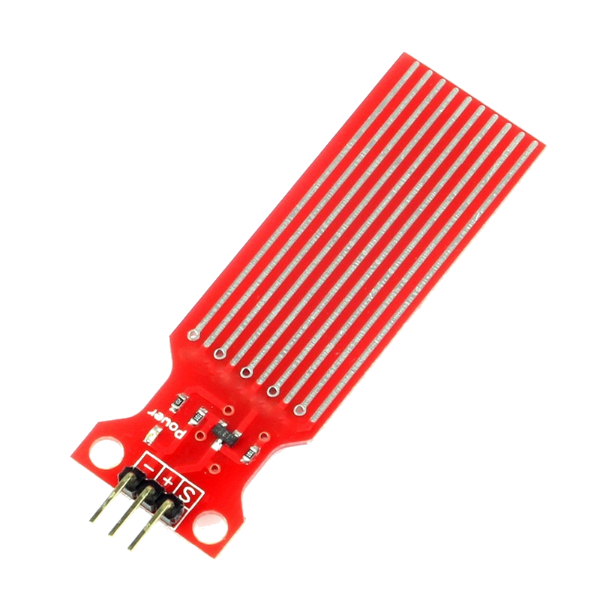
HARDWARE - SENSORS
Soil moisture
Measures how wet the soil is.
Used to determine when to activate the pump.
Water level
Measures how much water remains.

Slide 7
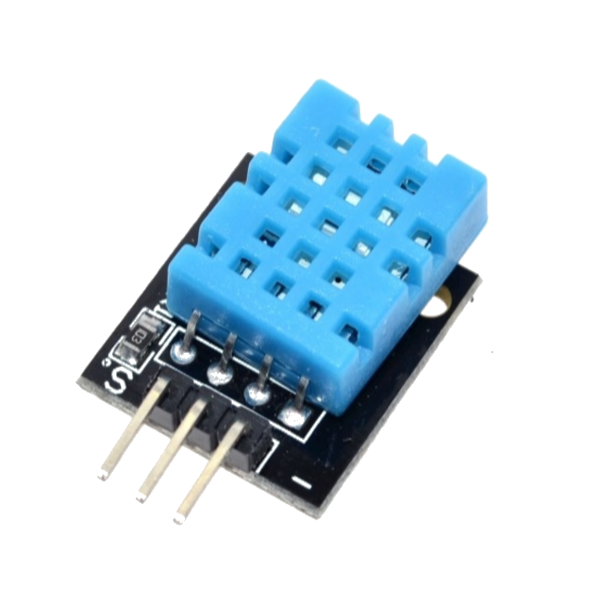
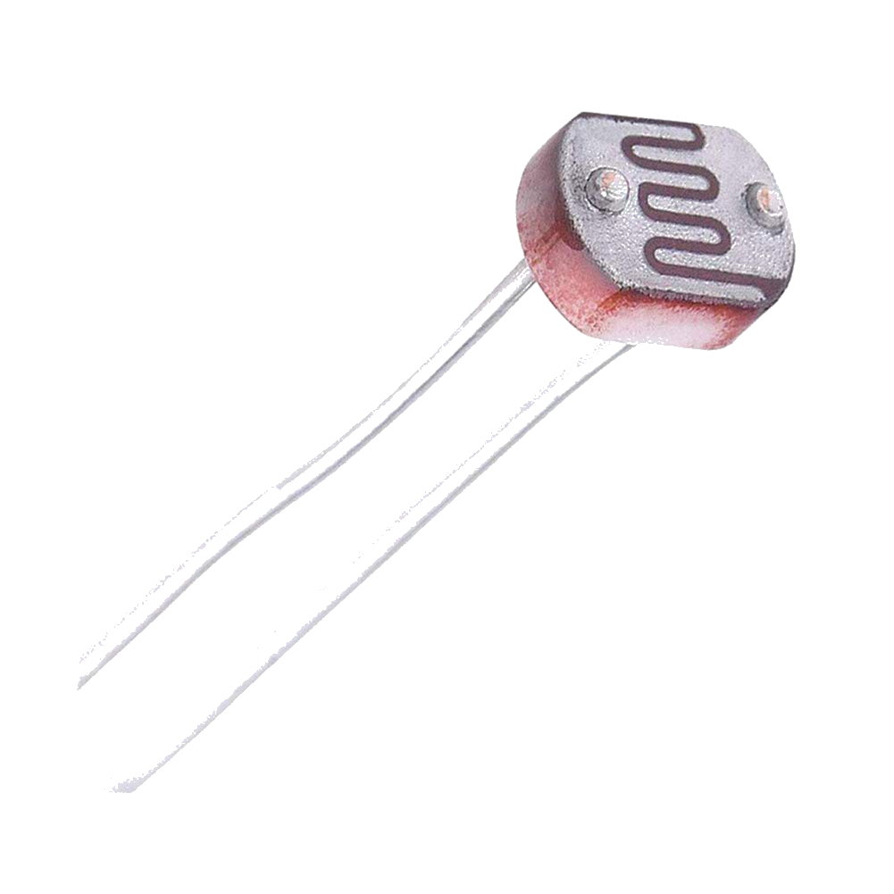
HARDWARE - SENSORS
Air HUMIDITY AND TEMPERATURE
Measures both temperature and humidity in the air next to the plant.
PHOTORESISTOR
Measures the light level near the plant.

Slide 8
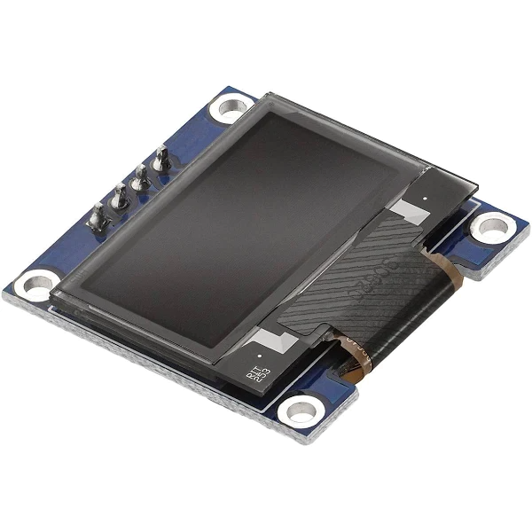
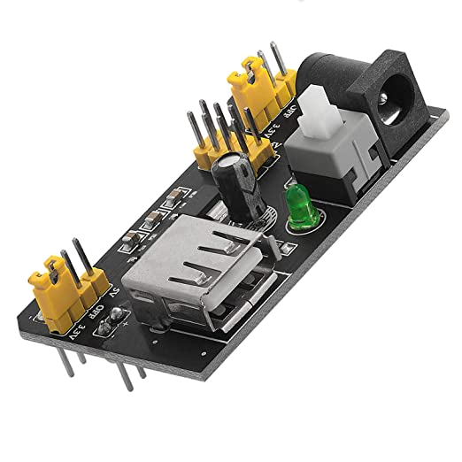
HARDWARE – DISPLAY and power supply
OLED DISPLAY
128x64 pixel resolution.
Displays status information and sensor measurements.
EXTERNAL POWER SUPPLLY
Takes 9v as input and can power 5v or 3.3v devices.
Powers most of the sensors and the pump controller.

Slide 9
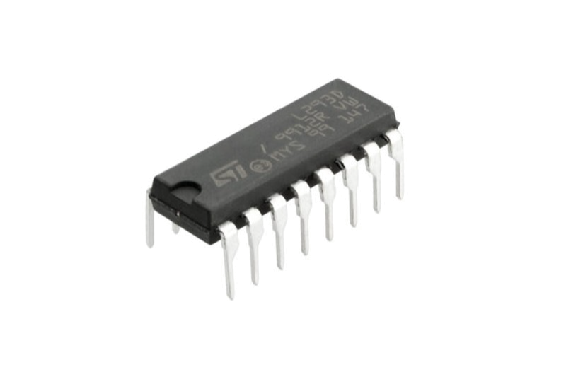
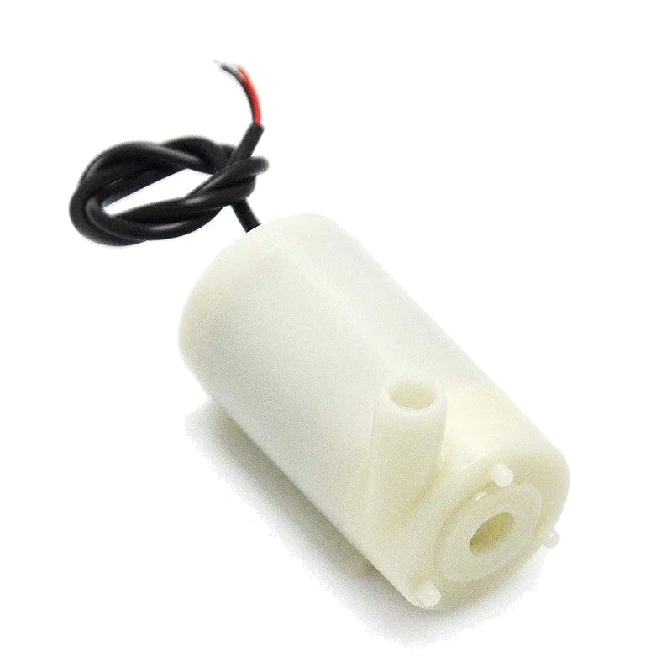
HARDWARE – Controller and pump
L293d motor driver
Can control up to 2 pumps at once.
Protects the board from any power discharge.
5v water pump
Sits in water.
Triggers based on soil moisture levels.

Slide 10
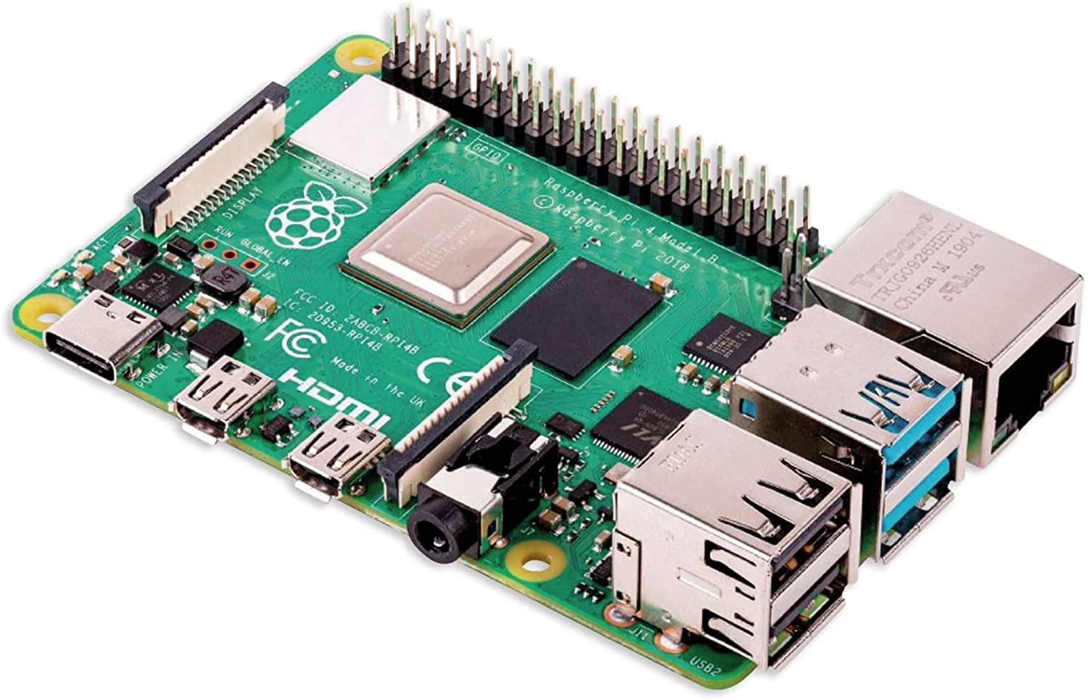
Hardware – raspberry Py
Linux-based RaspbianOS.
Quad core processor and up to 8GB RAM.
Great connectivity and various output ports.

Slide 11

MQTT COMMUNICATION
Mosquitto broker running on a Rapsberry Pi:
Collects messages from ESP32.
Web server subscribes to topics.
A topic for each measurement:
/iot/moisture
/iot/water
/iot/light
/iot/temperature
/iot/humidity

Slide 12

Nodejs server
NodeJS is widespred JavaScript backend framework.
Web server made with ExpressJS.
The server is responsible for:
Subscribing to the MQTT topics.
Handling requests for data from the client.
Notifying the user via email in case of anomalies

Slide 13

Vue client
VueJS is a versatile JavaScript frontend framework.
Modular component-based design.
Periodically retrieves the sensor measurements from the server.
Real-time charts made with ApexCharts.

Slide 14
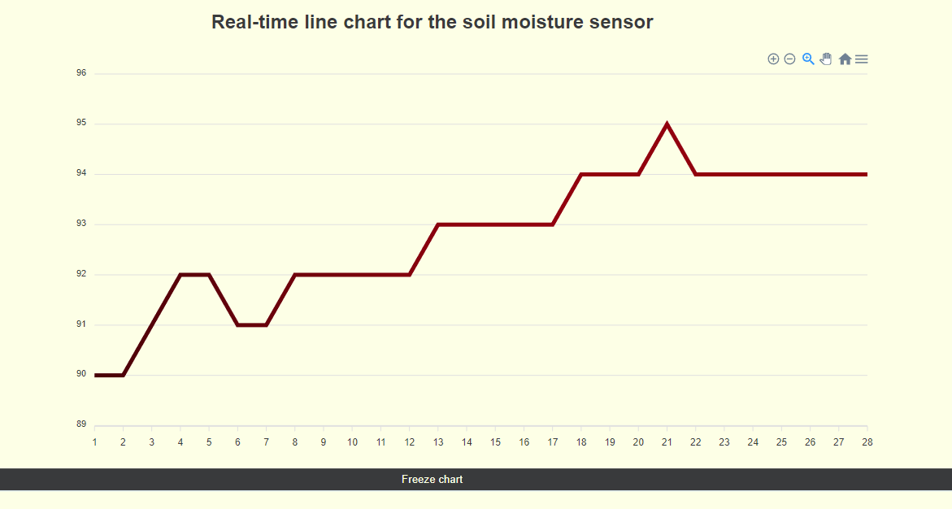
Moisture level real-time chart

Slide 15
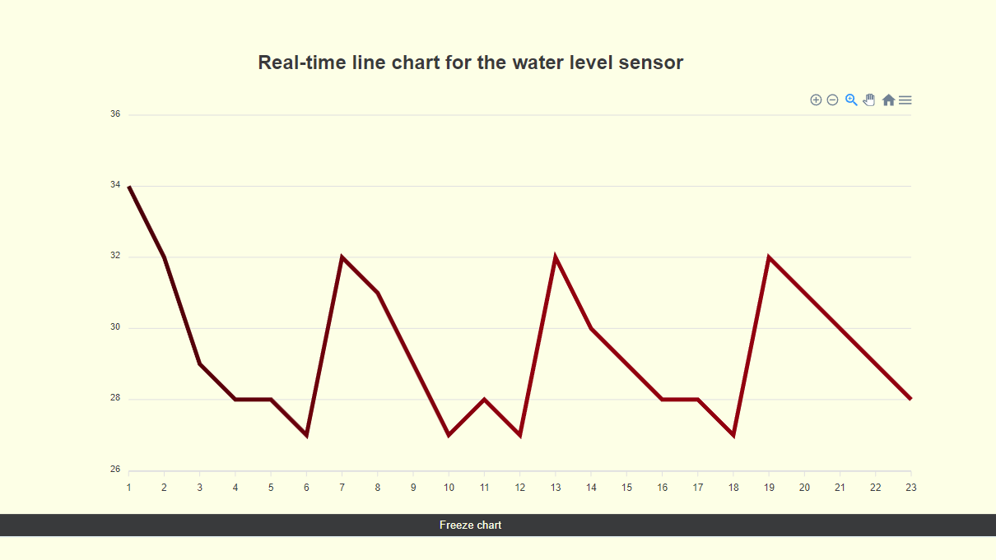
Water level real-time chart

Slide 16
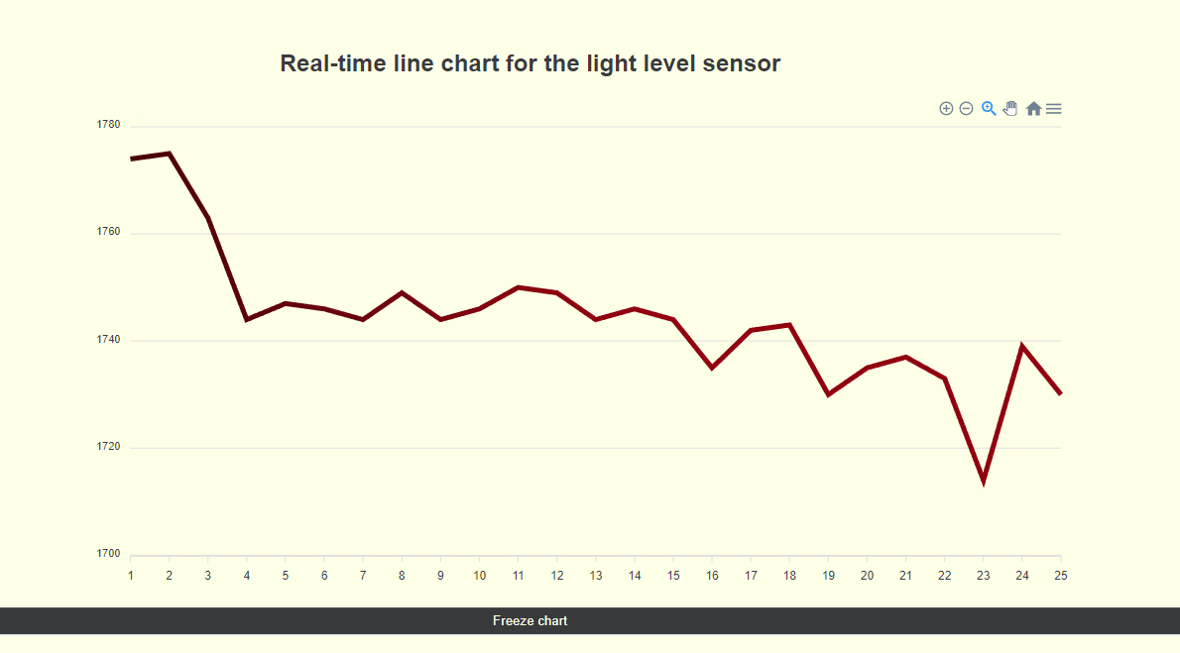
LIGHT LEVEL REAL-TIME CHART

Slide 17
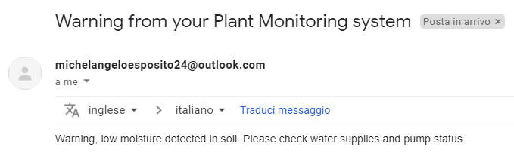
E-MAIL NOTIFICATION
Anomalies can be detected in the measurements, i.e.:
Low water level in the reserve.
Dangerous values for temperature/light…
In case this happens, the user is notified vie e-mail.

Slide 18
Thank you for the attention!

